Slide 1
Provo School District’s
Suicide Prevention Conference
Happiness:
A Matter of Life and Death
Frank Clayton, LPC

Slide 2
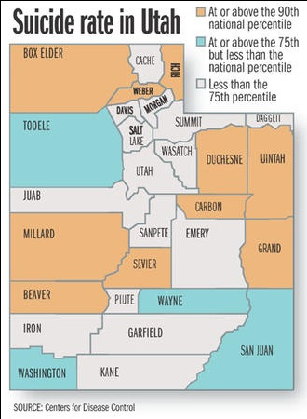
Courtesy of Deseret News

Slide 3


Slide 4
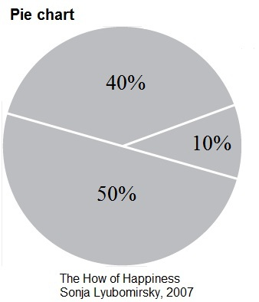

Slide 5
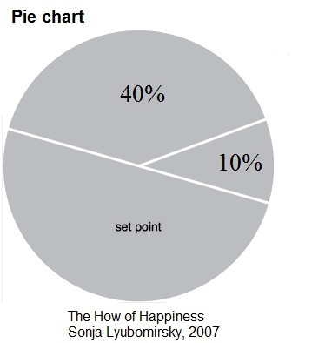

Slide 6
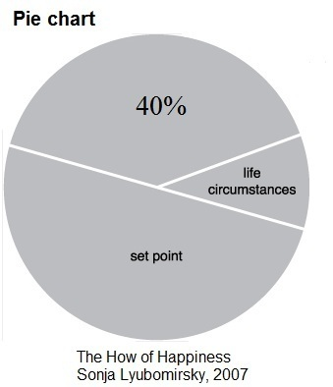

Slide 7
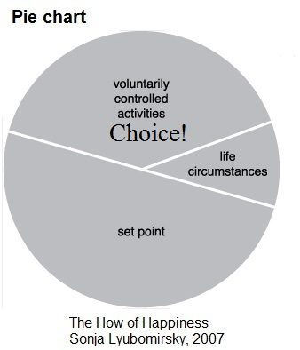

Slide 8
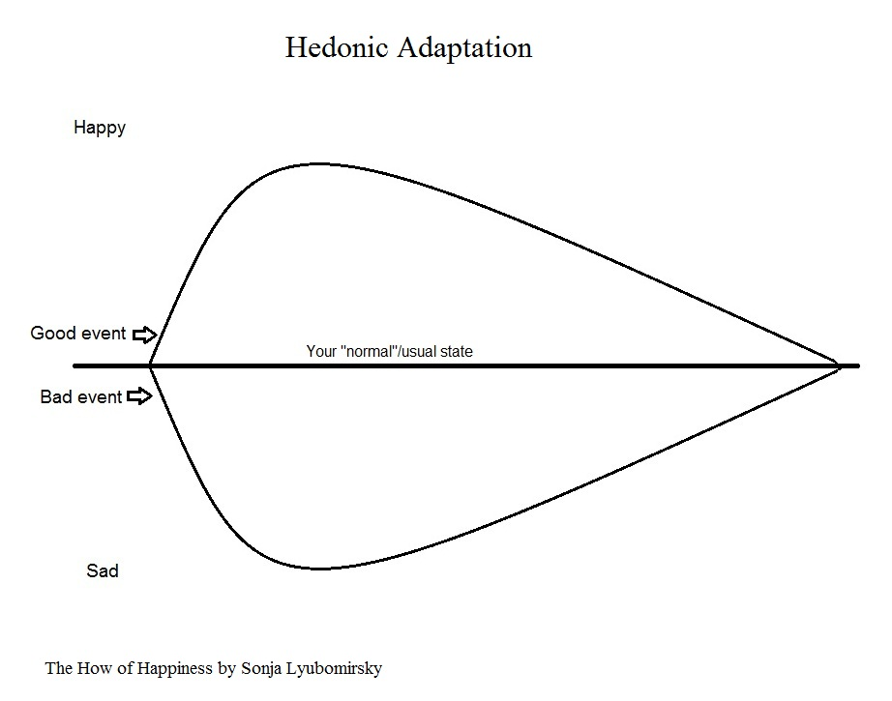

Slide 9
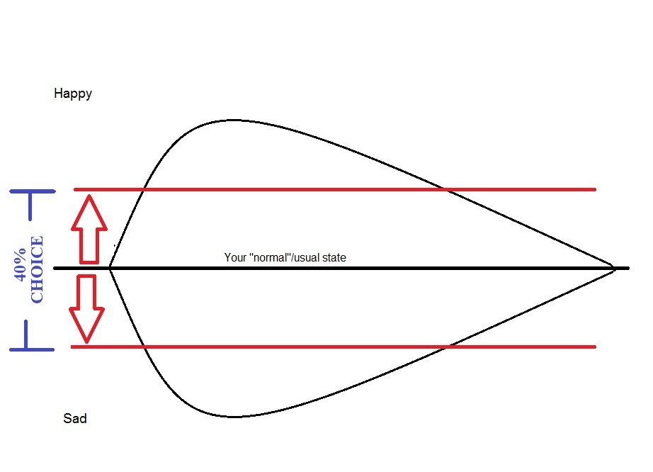

Slide 10
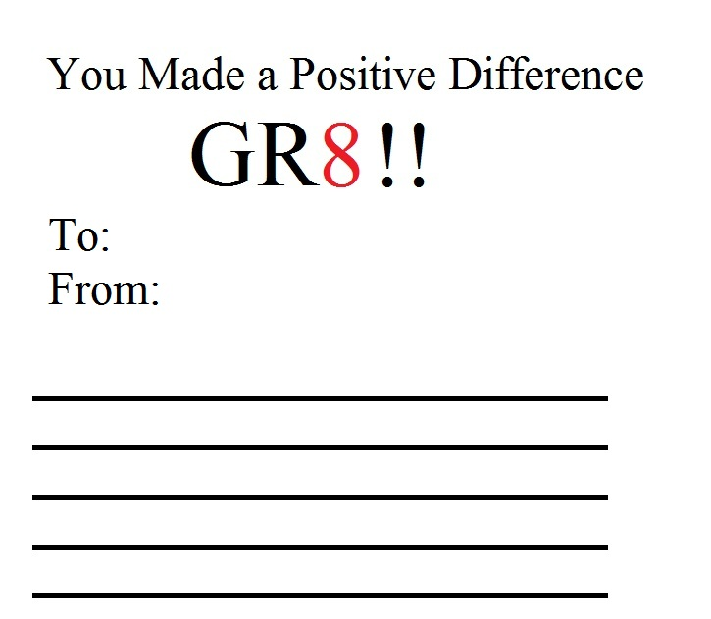

Slide 11
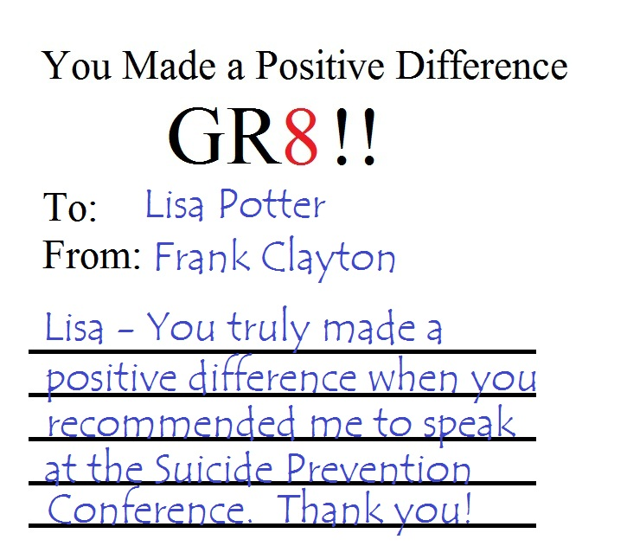

Slide 12
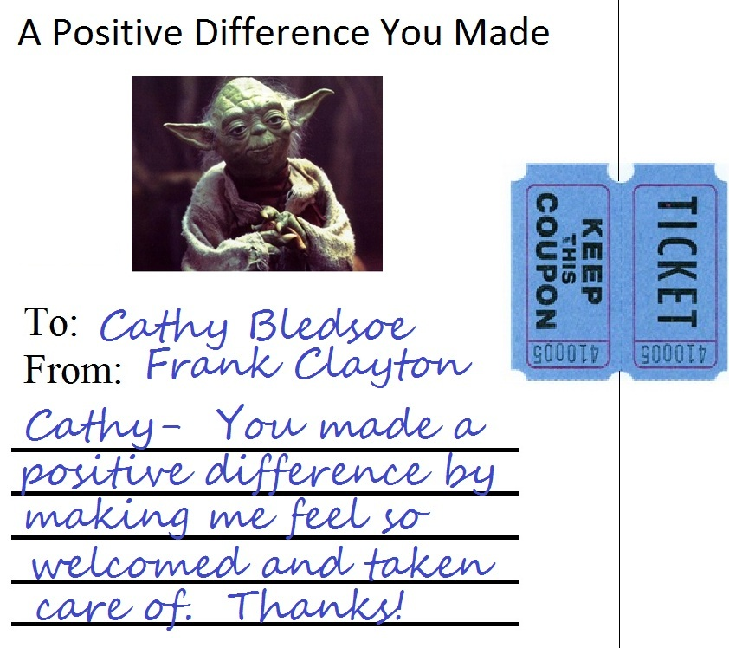

Slide 13
Provo School District’s
Suicide Prevention Conference
Happiness:
A Matter of Life and Death
Frank Clayton, LPC

